Slide 1



PERSONALIZED GPT MODEL
A COMPARATIVE STUDY
page 01
2025

Slide 2



Introduction
page 02
GPT (Generative Pre-trained Transformer) is a state-of-the-art AI model by OpenAI.
It understands and generates human-like text.
This project focuses on building a chatbot tailored specifically for institutional needs using a fine-tuned GPT model.

Slide 3
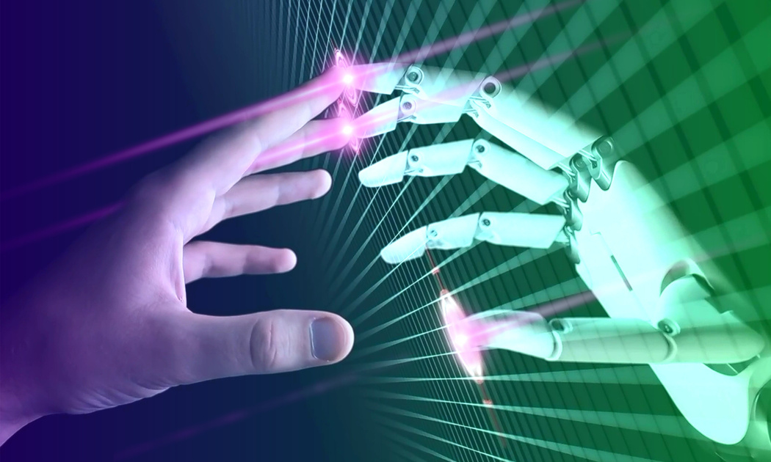
Vision: Smarter Institutions with Smarter Bots
Create a responsive, 24×7 virtual assistant for academic environments
Reduce manual workload by automating repetitive student queries
Deliver institution-specific answers with contextual accuracy
Set the foundation for smart, scalable AI solutions in education
page 03

Slide 4

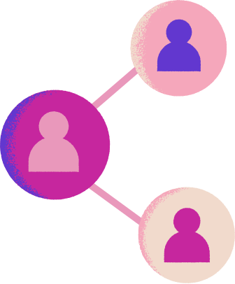


Technology Stack
FRONTEND: HTML, CSS, JAVASCRIPT
BACKEND: PYTHON, FLASK
page 04
AI INTEGRATION: OPENAI GPT (VIA API)
DATABASE: MONGODB

Slide 5


9. Sample Interaction
User Prompt: "What is the last date to pay semester fees?"
Bot Response: "The last date for semester fee payment is 30th July 2025."
The bot provides institution-specific answers not available in general GPT.
page 05

Slide 6

Security & Privacy
Security
Privacy
No user data stored
GPT access is encrypted and token-based
Training data restricted to institutional Q&A only
page 06

Slide 7
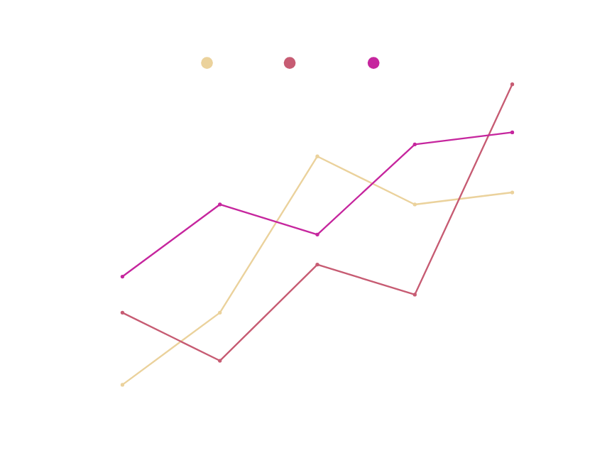
Fine-Tuning Process
Prompts and completions were formatted for training.
OpenAI’s fine-tuning pipeline was used.
Hyperparameters like learning rate and epochs were optimized.
Model was tested iteratively for accuracy.
page 07

Slide 8


Future Scope of GPT Model
Add voice input and mobile app support
INTRODUCE MULTI-LANGUAGE SUPPORT
Introduce multi-language support
page 09
INTRODUCE MULTI-LANGUAGE SUPPORT
Create an adn panel for dynamic data updates

Slide 9

Conclusion
Summary
The chatbot enhances student interaction with institutional systems.
It's scalable, secure, and user-friendly.
Can be adapted for other educational or corporate institutions.
page 10

Slide 10
THANK YOU!
MORE INFORMATION: CHANDRIKABIJORE@GMAIL.COM
page 11

